Slide 1
BLOOD BANK MANAGEMENT SYSTEM
Here is where your presentation begins

Slide 2
Table of contents
01
03
05
02
04
06
INTRODUCTION
PACKAGES INSTALLED
LOGIN PAGE
What is Blood Bank Management System?
Through which you’ll enter the main page.
Packages like bcrypt,mongoose,axios etc.
TECHNOLOGIES USED
WELCOMING PAGE
OTHERS
Rest of the project (including dashboard,analyt-ics etc.)
Various technologies used in the project
The Homepage of the project

Slide 3
INTRODUCTION
The Blood Bank Management System using the MERN (MongoDB, Express.js, React.js, Node.js) stack is designed to efficiently manage and streamline the processes involved in a blood bank. This web-based application helps blood banks, hospitals, and other healthcare organizations to maintain and organize their blood inventory, donor information, and other related data

Slide 4
TECHNOLOGIES USED
MongoDB: A NoSQL database for efficient and scalable data storage.
• Express.js: Serving as the backend framework, Express.js enables the creation of a powerful and flexible API.
• React: The frontend is developed using React, allowing for a dynamic and responsive user interface.
• Node.js: As the runtime environment, Node.js ensures efficient server-side execution.

Slide 5
PACKAGES INSTALLED
bcrypt: Employed for password hashing, ensuring the security of user credentials.
• jsonwebtoken: Facilitates tokenization for user authentication and session management.
• mongoose: Used to establish a connection between the application and the MongoDB database.
• axios: Integrated into the React frontend for making API requests to the backend, facilitating CRUD operations.

Slide 6
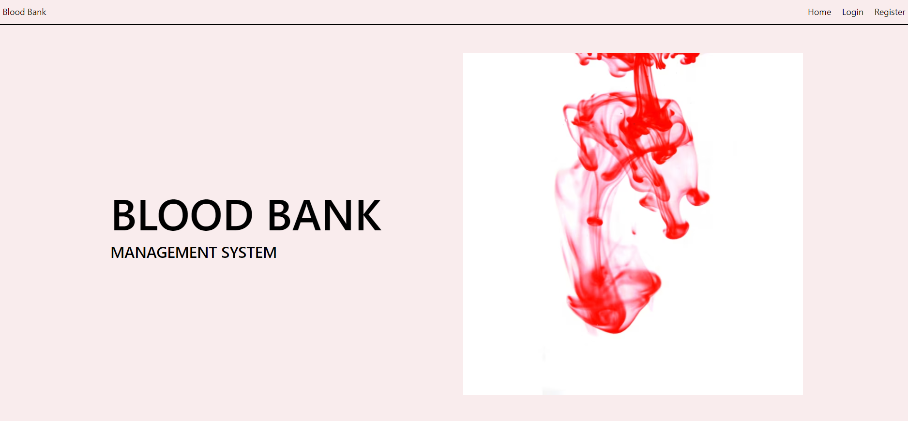
WELCOMING PAGE

Slide 7

LOGIN PAGE

Slide 8

REGISTER PAGE

Slide 9
ROLES TO LOGIN
DONAR→If you login as donar you can see how much donations have you done
and which organisation handles you.
ADMIN→ If you login as an admin you can see the donar list,the hospitals list and
the organisations list.
HOSPITAL→ If you login as hospital you can see how much blood have you consumed and which organisation handles you.
ORGANISATION→If you login as an organisation you can add inventories,see donars and hospitals.

Slide 10
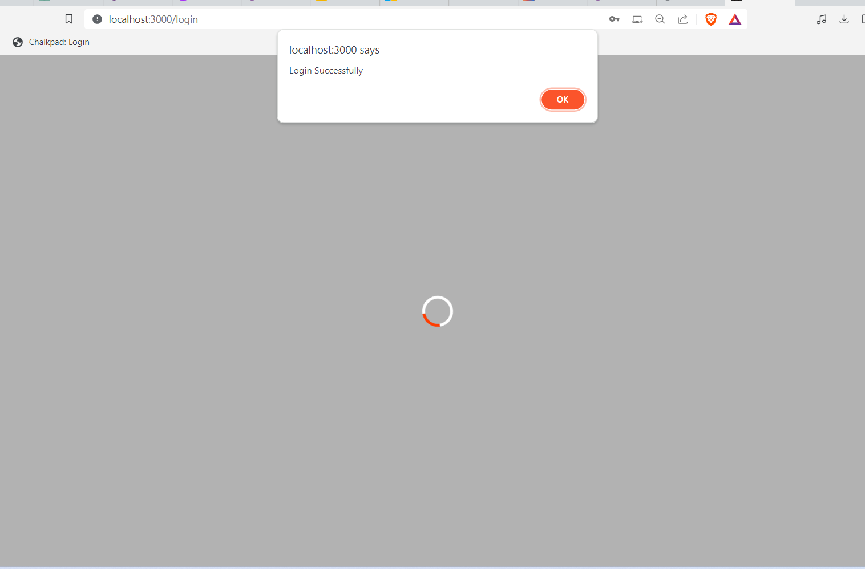
1.DONAR
The server starts loading the page
and until you click ok ,it won’t enter the main page.

Slide 11
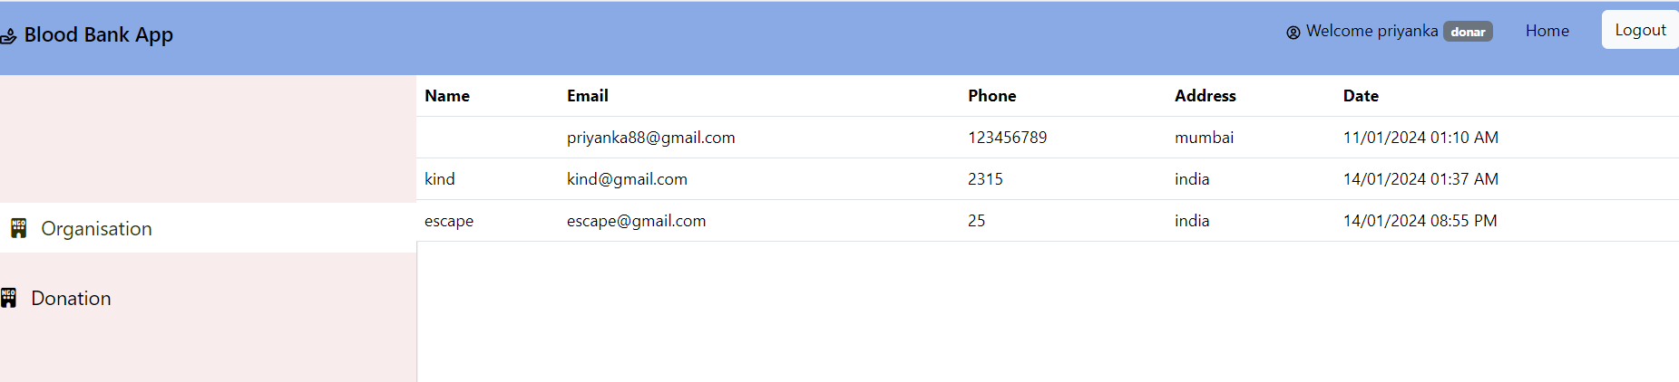
ORGANISATION IN DONOR
This will show all the organisations that handle the particular donar.

Slide 12
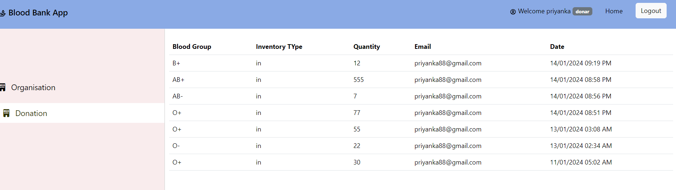
DONATION IN DONOR
This will show all the donations made by the particular donar.

Slide 13
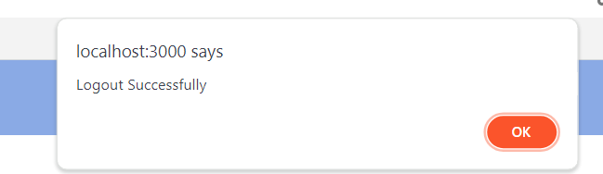
LOGOUT BUTTON
As soon as you click on LOGOUT button, it will ask you again whether you are sure or not.

Slide 14
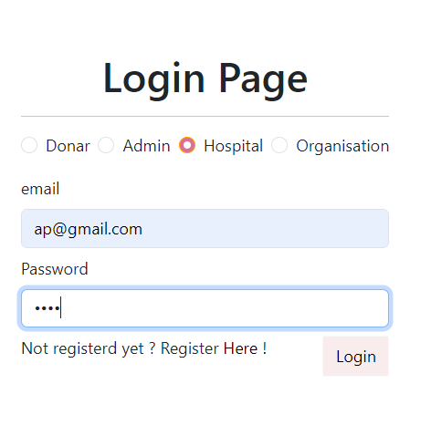
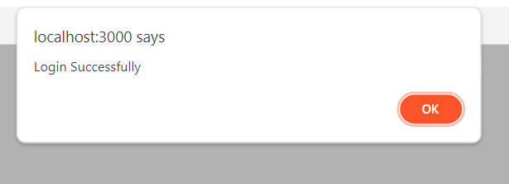
2.HOSPITAL

Slide 15
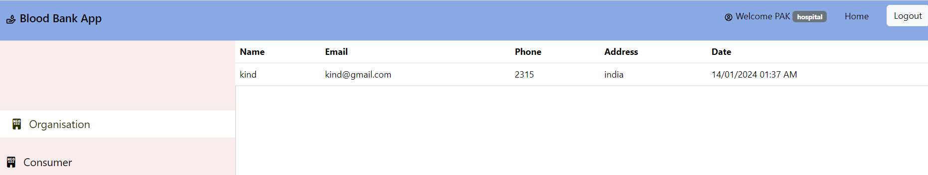
ORGANISATION IN HOSPITAL
This will show all the organisations that handle the particular hospital.

Slide 16
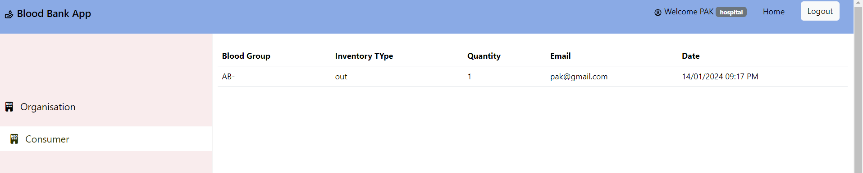
CONSUMER IN HOSPITAL
This will show the blood type and quantity consumed by the hospital.

Slide 17
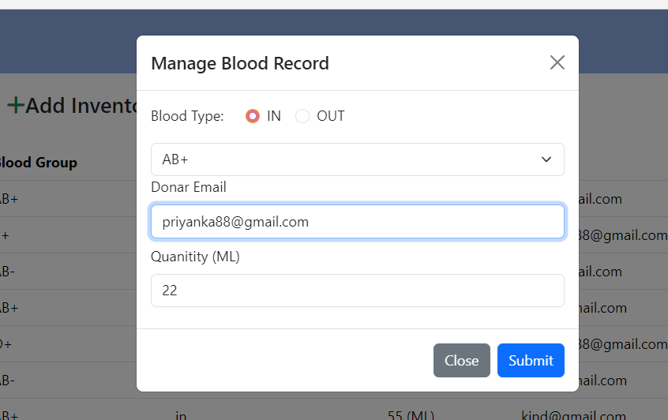
3.ORGANISATION
By clicking on Add Inventory,you can add the blood records of donars and hospitals.

Slide 18
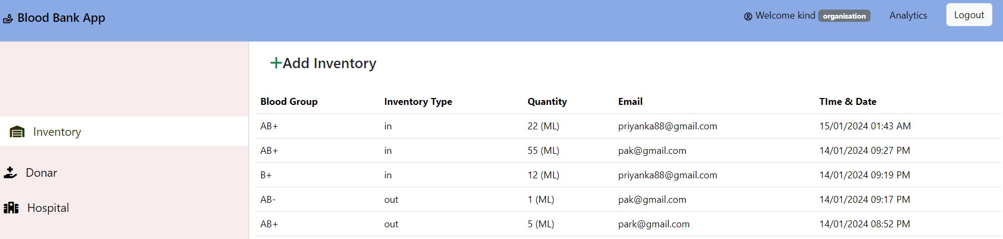
INVENTORY IN ORGANISATION
This will show you all the blood records whether in or out.

Slide 19
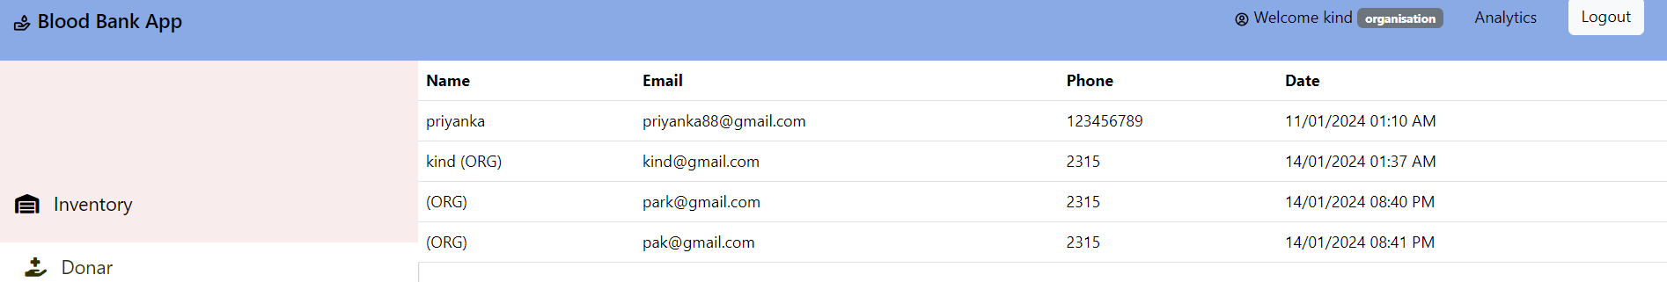
DONARS IN ORGANISATION
This will show you all the blood records of donars.

Slide 20
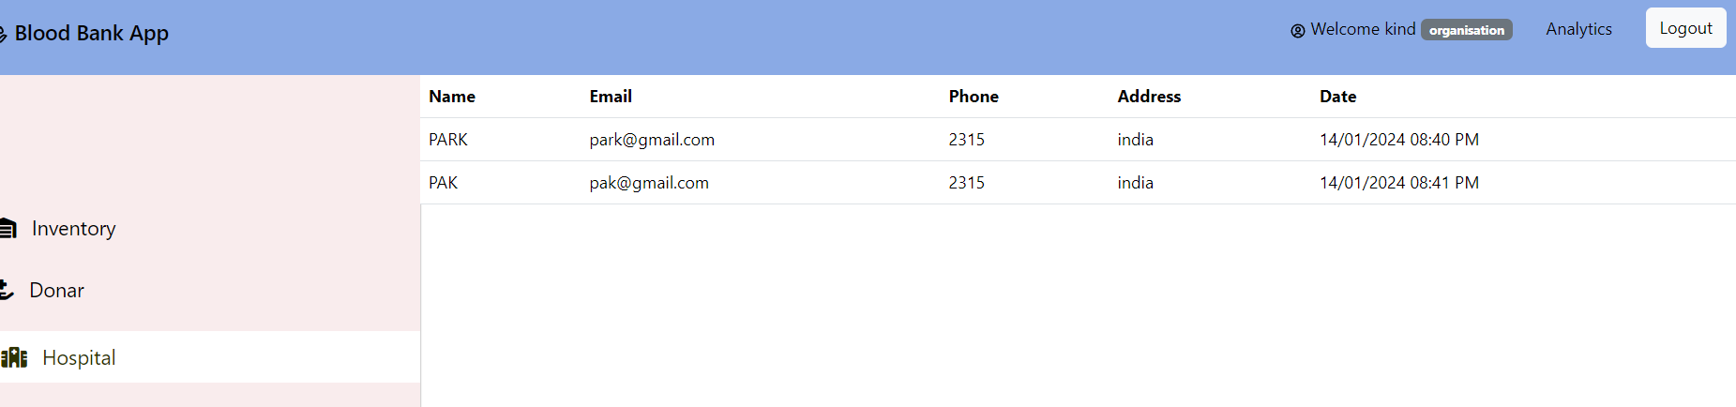
HOSPITAL IN ORGANISATION
This will show records of hospitals that have consumed blood.

Slide 21
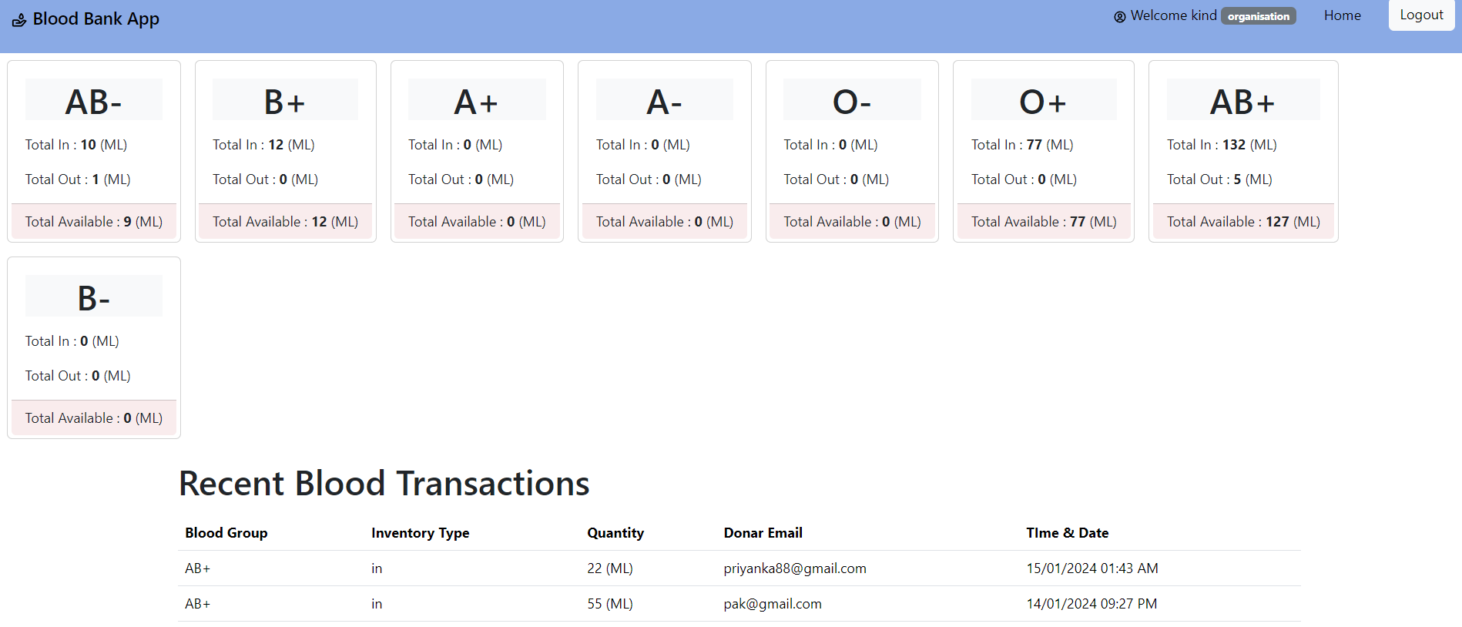
ANALYTICS IN ORGANISATION
This will show the available , total in, and total out blood.

Slide 22
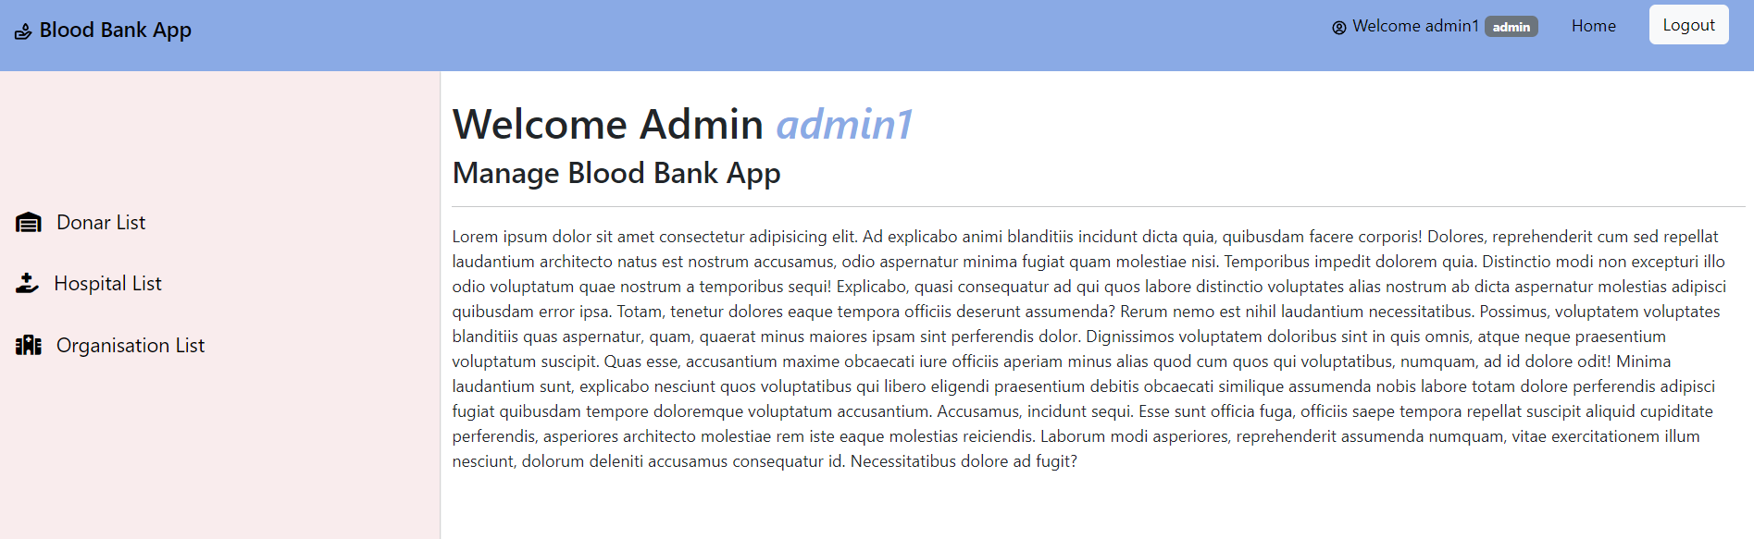
4. ADMIN

Slide 23
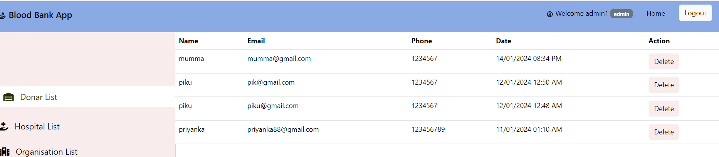
DONAR LIST IN ADMIN
This will display all the donars list

Slide 24
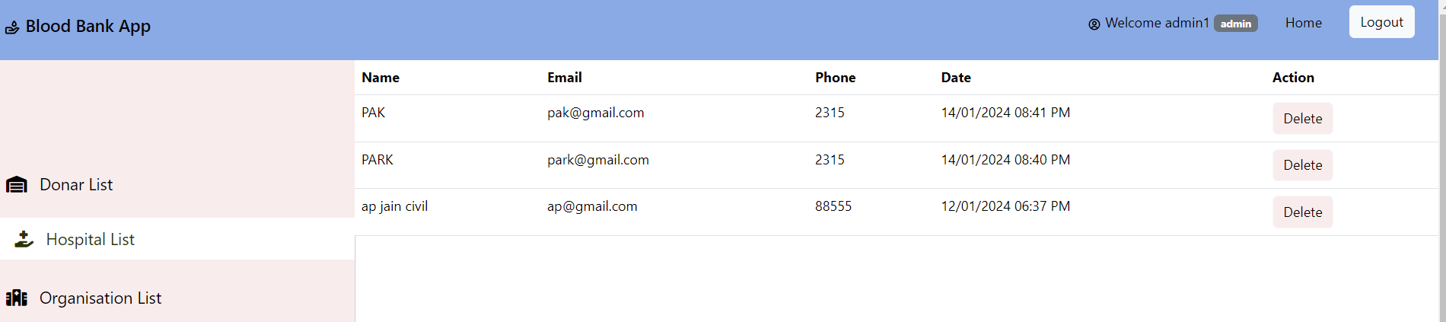
HOSPITAL LIST IN ADMIN
This will display all the hospitals list

Slide 25
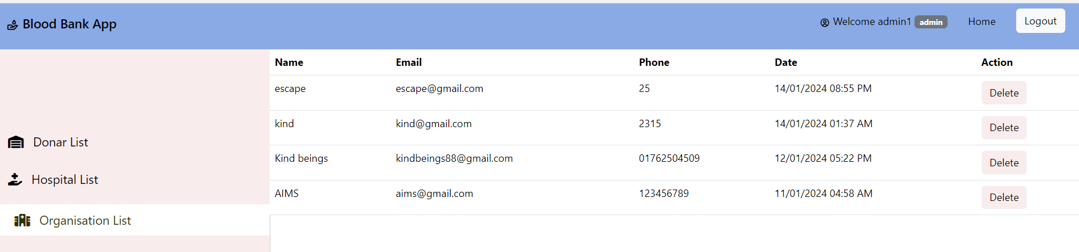
ORGANISATION LIST IN ADMIN
This will display all the organisations list that have logged in.

Slide 26
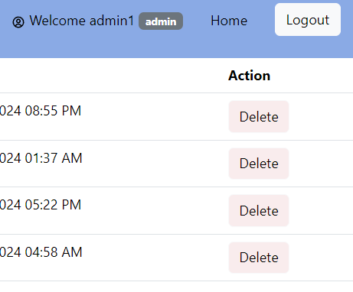
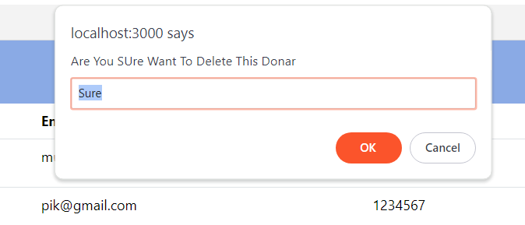
DELETING A RECORD IN ADMIN
By clicking on delete button you can delete a record

Slide 27
THANK
YOU!

